Slide 1
English III Week 16

Slide 2
Today’s Class
Warm-Up
Practice Test – Reading
Essay feedback
BREAK
Listening: TED Talk – The Science of Motivation

Slide 3
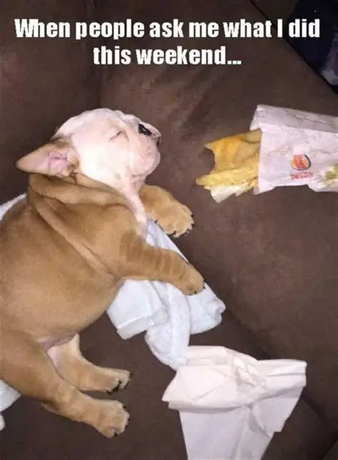
How was your weekend?
5 minutes!

Slide 4



INTRODUCTION
ARGUMENTATIVE ESSAY FINAL DRAFT
And REFLECTION
Due: By Monday, December 29th 2025 by 23:59
Turn in on Blackboard
You can give a brief description of the topic you want to talk about here. For example, if you want to talk about Mercury, you can say that it’s the smallest planet in the entire Solar System

Slide 5
Dos and Don not’s
YES!
NO!
Type your essay (size 12 Times New Roman Font, double-spaced)
Use AI and online tools to help you: correct grammar and punctuation mistakes, choose vocabulary, cite sources
Add a few facts/statistics for support and to expand your arguments
Add a reference page (optional)
Change your topic or arguments
Use AI to write entirely new paragraphs
Add more than 10% of new information to your essay

Slide 6

Your essay should show a clear progression of development and improvement from the first to final draft. However, it should be recognizable. Do not drastically alter the final draft! Feel free to expand ideas, conclusions, and add a small amount of supporting details. However, the new/added information should not amount to more than 10% of the overall essay!

Slide 7
REFLECTION
200 Words!
How did each phase of the writing process (outline, first draft, peer review, second draft, teacher feedback, final draft) help you build the final draft? What changes did you make along the way? Which parts were most helpful?
How did you use AI tools to enhance the final draft? Which did you use? For what?
What did you learn from this experience? How will you continue to improve your English writing in the future?
Turn in on Blackboard!

Slide 8
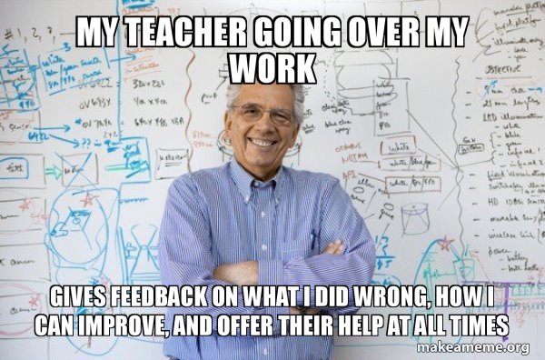

Slide 9
General Vocabulary, Grammar, and Punctuation
Example: Countable vs. Uncountable Nouns
(Information, knowledge, advice, equipment, data, homework, research, artwork)
You CAN use online tools!

Slide 10
2. Academic Tone
Choose strong academic vocabulary
Avoid first AND second person in most situations
Example: “What if you could fly. Where would you go?”
…. “Imagine if people had the ability to fly and the places they could go”.

Slide 11
3. Thesis Statements
Location: Last sentence of paragraph ONE (Introduction)
Only one sentence
Should clearly state the essay’s position and three arguments
Avoids first person statements such as : “I will tell you about..” or “In my opinion…”

Slide 12

Imagine a group of friends excitedly opening a box of pizza to celebrate the end to a busy semester. They pull out slices, anticipating delicious flavors of cheese, ham, and sauteed onion. However, upon taking the first bites each is hit with an overwhelmingly potent taste: the tang of pineapple, which instantly overpowers everything else. According to an article published in Time Magazine, the surprising pairing was first unveiled in Ontario Canada, by a restaurant owner experimenting with sweet plus savory flavor combinations. It’s been a hotly debated issue ever since, though the answer seems abundantly clear. Pineapple simply does not belong on pizza because it creates an unpleasant flavor imbalance, has a distracting texture, and causes loss of cultural authenticity.

Slide 13
4. Sources
Be sure to specify where supporting material came from
Cite people, organizations, dates, etc. in the text with phrases like:
“according to ____________”. “In research from ________”
“In a recent study by_____________”

Slide 14


Slide 15

WHOA!
What motivates you to do well in school? (goals)
Who/what can help to motivate you?
What do you do when you feel unmotivated?
Describe a time when you had to be extremely motivated in order to succeed. What did you do?
What is an area of your life where it is hard to find the motivation?
Does competition help to motivate you?
Do you often reward yourself for achieving a goal?
This can be the part of the presentation where you introduce yourself, write your email…

Slide 16

The power of communication

Slide 17
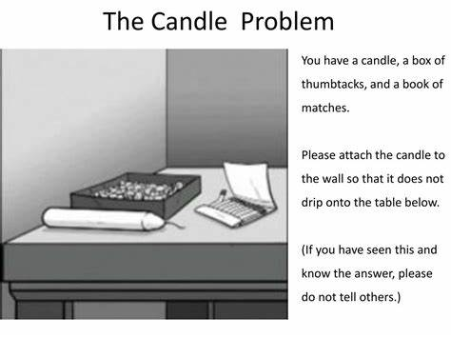

Slide 18
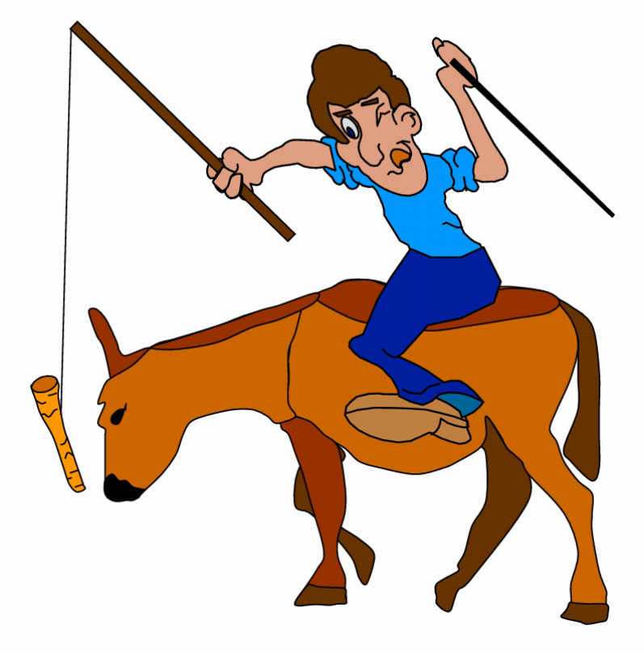
Discussion Questions
When you were a child, did your parents offer you incentives to do your homework?
Which do you think is more important: Intrinsic or Extrinsic Motivation?
In which ways do you have more autonomy in university than in secondary school?
What is a skill you’d like to have mastery in?

Slide 19
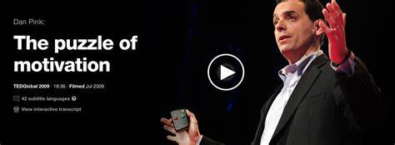

Slide 20
What did the speaker originally study in school? Was he a good student?
What did he mean by “Functional Fixedness” when describing The Candle Problem?
How was the original experiment conducted? What did they learn about incentives?
In what circumstance do incentives work? Why?
Why is this important in today’s world?
What happens at Australian company “Atlassian’s” FedEx Days?
What was the difference between the approaches to creating Microsoft Encarta and Wikipedia?

Slide 21
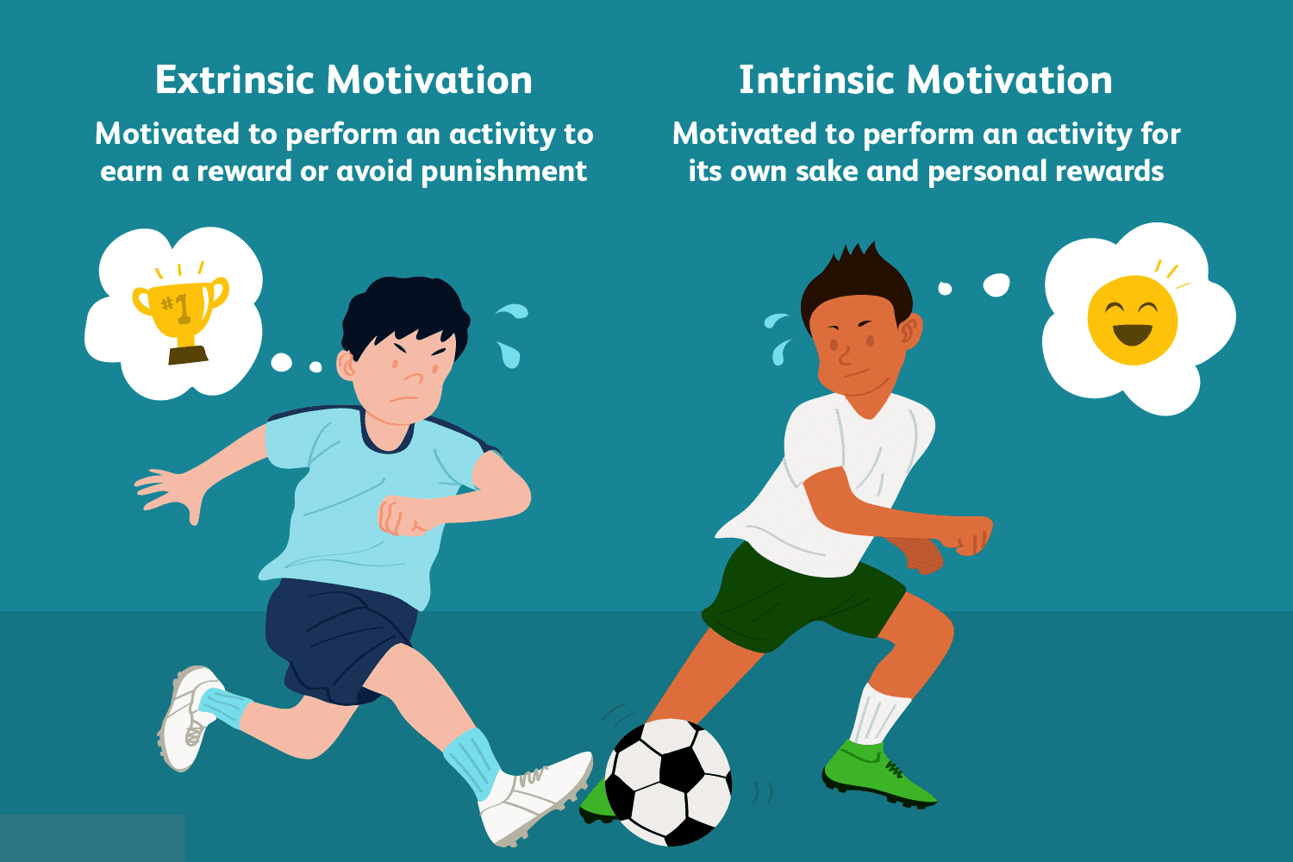
What are your thoughts?

Slide 22
Thank you

